Slide 1
WORLD OF LASERS
Laser Application: Energy

Slide 2
ENERGY
In the future, high-power laser systems might play a role in electricity generation.

Slide 3
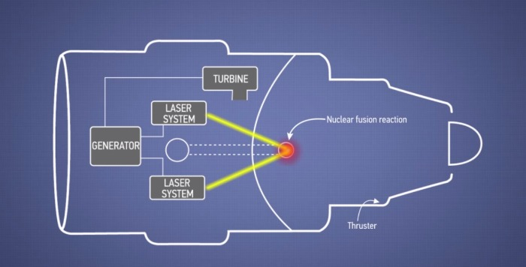
ENERGY
Laser-induced nuclear fusion is investigated as an alternative to other types of fusion reactors.

Slide 4
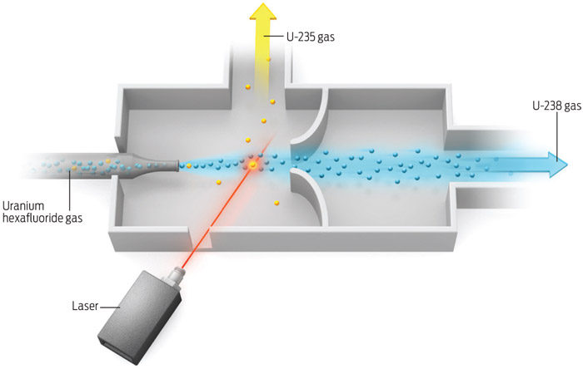
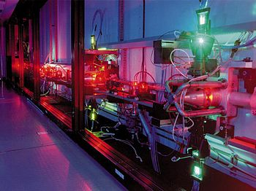
ENERGY
High-power lasers can also be used for isotope separation.

Slide 5
?
WELL DONE!
Move on to the next laser application...
MILITARY!

